Slide 1
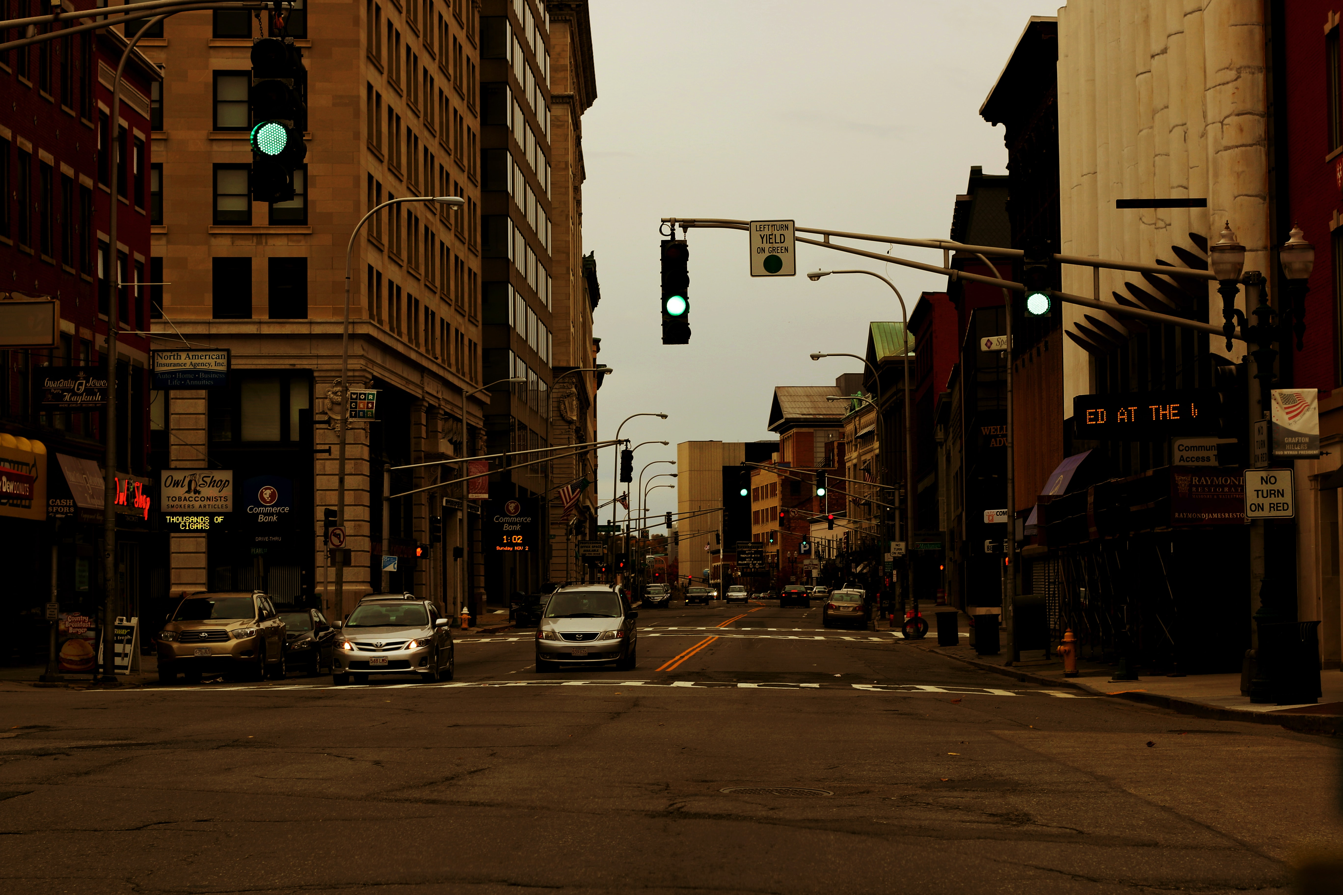


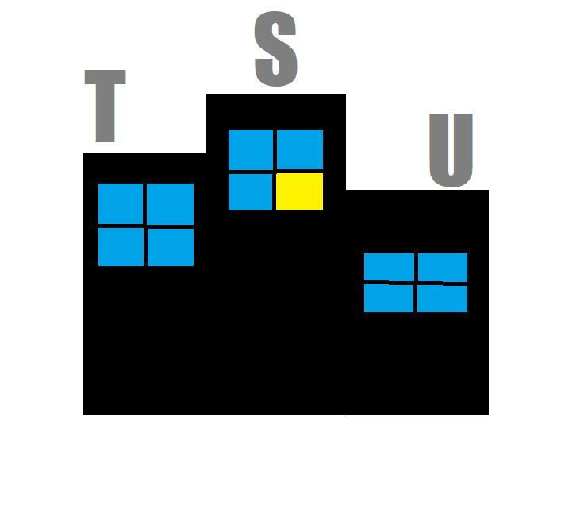

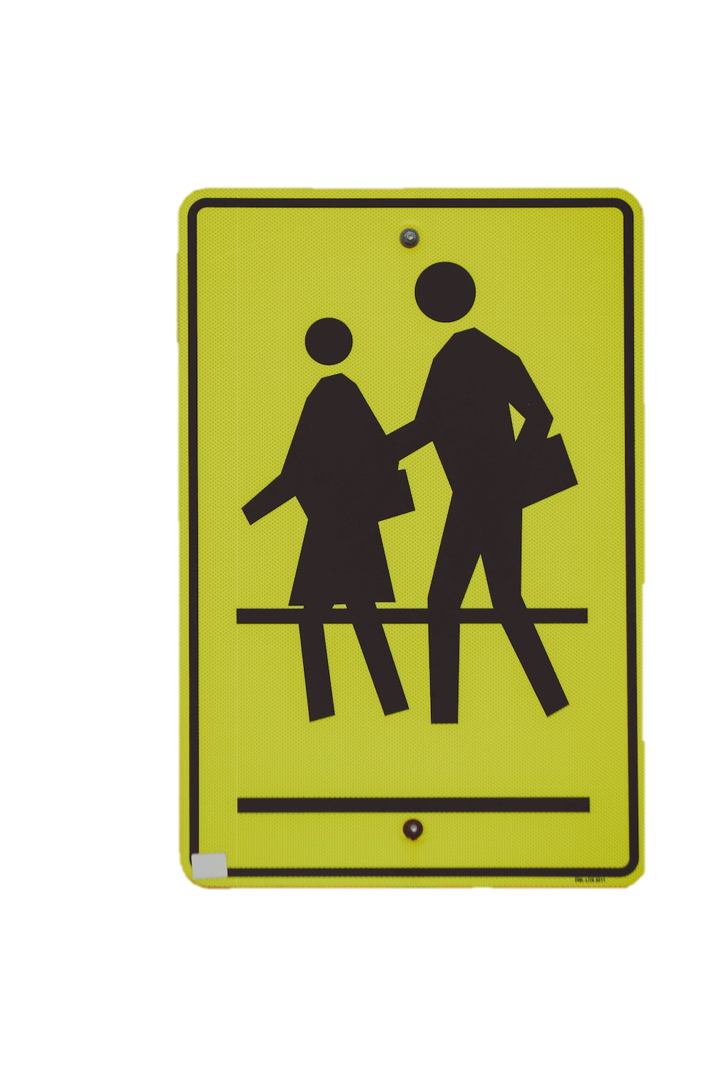





















A More Walkable Worcester
Krishna Garg, Pranav Jain, Piotr Skoczylas, Anthony Burns, Andy Lamprey
Citations
Citations
Carole. (2022, July 1). Accessible Pedestrian Signals: the Ultimate Guide. Inclusive City Maker. https://www.inclusivecitymaker.com/guide-accessible-pedestrian-signals/
Crime rate in Worcester, Massachusetts (MA): Murders, rapes, robberies, assaults, burglaries, thefts, auto thefts, arson, law enforcement employees, police officers, crime map. Crime in Worcester, Massachusetts (MA): murders, rapes, robberies, assaults, burglaries, thefts, auto thefts, arson, law enforcement employees, police officers, crime map. (n.d.). Retrieved December 4, 2022, from https://www.city-data.com/crime/crime-Worcester-Massachusetts.html
Fournier, N. (2021, September 6). Hybrid pedestrian and transit priority zoning policies in an urban street network: Evaluating network traffic flow impacts with analytical approximation. Transportation Research Part A: Policy and Practice. Retrieved November 4, 2022, from https://www.sciencedirect.com/science/article/pii/S0965856421002159
Gase, Lauren. “Public Awareness of and Support for Infrastructure Changes Designed to Increase Walking and Biking in Los Angeles County.” Science Direct, 2015, www-sciencedirect-com.ezpv7-web-p-u01.wpi.edu/science/article/pii/S0091743514005155
Maurer Braun, L., Read, A., & Ricklin, A. (2016). The Benefits of Street-Scale Features for Walking and Biking. Journal of Transport & Health, 3(2), S22. https://doi.org/10.1016/j.jth.2016.05.060
Michael, Andersen. March 16, 2015. Here's what keeps people from riding a bike. Greater Washington. Retrieved November 18, 2022, from https://ggwash.org/view/37584/heres-what-keeps-people-from-riding-a-bike
Pedestrian Infrastructure. (n.d.). Streetsmart. http://www.thinkstreetsmart.org/pedestrian-infrastructure.html
Pitner, R. O., Yu, M., & Brown, E. (2012). Making neighborhoods safer: Examining predictors of residents’ concerns about neighborhood safety. Journal of Environmental Psychology, 32(1), 43–49. https://doi.org/10.1016/j.jenvp.2011.09.003
Strauss, I. (2021, September 21). Is the U.S. becoming more bike friendly? Environment. Retrieved November 18, 2022, from https://www.nationalgeographic.com/environment/article/is-the-us becoming-more-bike friendly#:~:text=Safety%20first&text=Why%20don't%20they%20bike,on%20every%20street%2C%20Pucher%20said.
Urbanization. Understanding Global Change. (2022, March 8). Retrieved November 2, 2022, from https://ugc.berkeley.edu/background-content/urbanization
Velasquez, Douglas, J. A., Guo, F., & Robinette, J. W. (2021). What predicts how safe people feel in their neighborhoods and does it depend on functional status? SSM - Population Health, 16, 100927–100927. https://doi.org/10.1016/j.ssmph.2021.100927
Problem
Causes
Worcester as a city at present is very pedestrian unfriendly. On main roads such as Highland and Institute there are many hills, messy sidewalks, and nonfunctional or missing walk lights.
Effects
Safety concerns
Lack of pedestrian infrastructure
Convenience
More vehicle related accidents
Higher emission rates
Inefficient land use
Article Research
Goal
Survey Data Analysis
Safety concerns
Convenience
Safety concerns correlated to crime rates
To present some practical steps forward as to make the pedestrian lifestyle safer and more appealing.
Cars are most popular form of daily transportation
This is mainly due to infrastructure and safety concerns
Car Use in Urban Areas
Modes of Transport Used in Worcester
Car
Bus
Carpool
Train
Biking
Walking
Safe to Walk/ Bike Worcester
91.2%
Yes
8.8%
61.8%
38.2%
No
11.8%
55.9%
11.8%
Yes
Solutions
No
14.7%
44.1%
70.6%
Improve City Infrastructure
Promote Walking/ Biking in Worcester
Provide Public
E-Bikes
Pros
Makes pedestrian lifestyles safer therefore more appealing
Pros
Biking will become more appealing
Reduce the cons of biking daily
Cons
Can be costly
Does not handle the seasonal impacts on biking
Cons
Can be costly
Will take time
Hard to implement
Pros
Easy to implement
Makes walking/biking more appealing
Cons
Little guarantee it will work
Takes a lot of time

